Slide 1

ARP SPOOFING
Team Members :
Venu Gopal Reddy - S20220010037
Dhanush Bhupathi - S20220010038
Leela Prasad - S20220010135
Bala Venkata Pavan - S20220010040

Slide 2
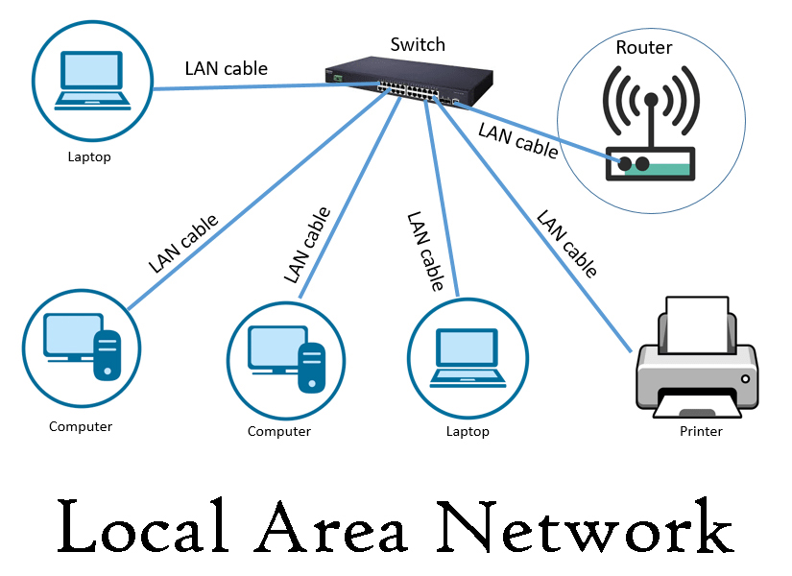
What is Local Area Network (LAN)?
A Local Area Network (LAN) is a network that connects computers and other devices within a limited area, like a home, office, or school.
What is MAC ?
A MAC address is a unique identifier assigned to a network interface. Physical machine address also known as MAC

Slide 3
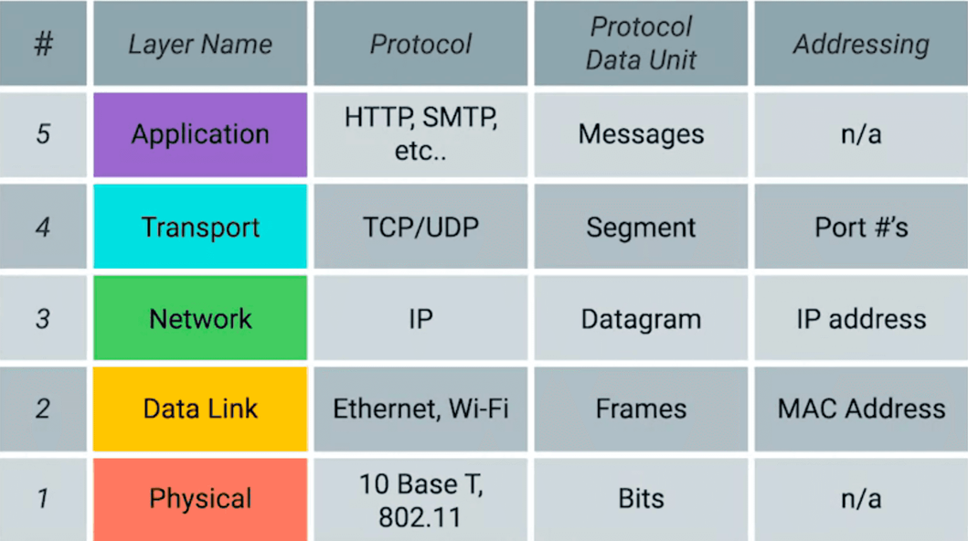
Why we use Mac over I.P in LAN?
MAC addresses operate at the Data Link Layer which is
responsible for direct communication between devices on the same local network.
01
02
IP addresses operate at the Network Layer which handles communication between different networks.
MAC addresses enable direct device-to-device communication within a LAN whereas IP addresses require a routing process
03
From above Information , We got to know that We use Mac address is required to communicate in Local area Network
To find the MAC address of device A, we use an IP-to-MAC address mapping system

Slide 4
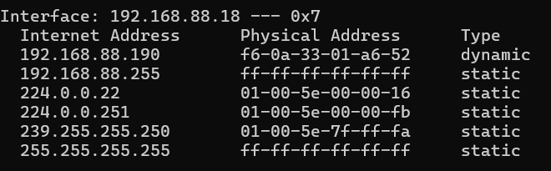
How do we determine the mapping between an IP address and a MAC address, or vice versa?

Slide 5
How is the ARP table populated for local network communication?
To accomplish this, we use the Address Resolution Protocol (ARP).
For this purpose, a specific protocol called ARP (Address Resolution Protocol) is used to map IP addresses to MAC addresses.
How do we obtain the MAC address of an unknown device on our network?
To do this, we use the ARP (Address Resolution Protocol).

Slide 6
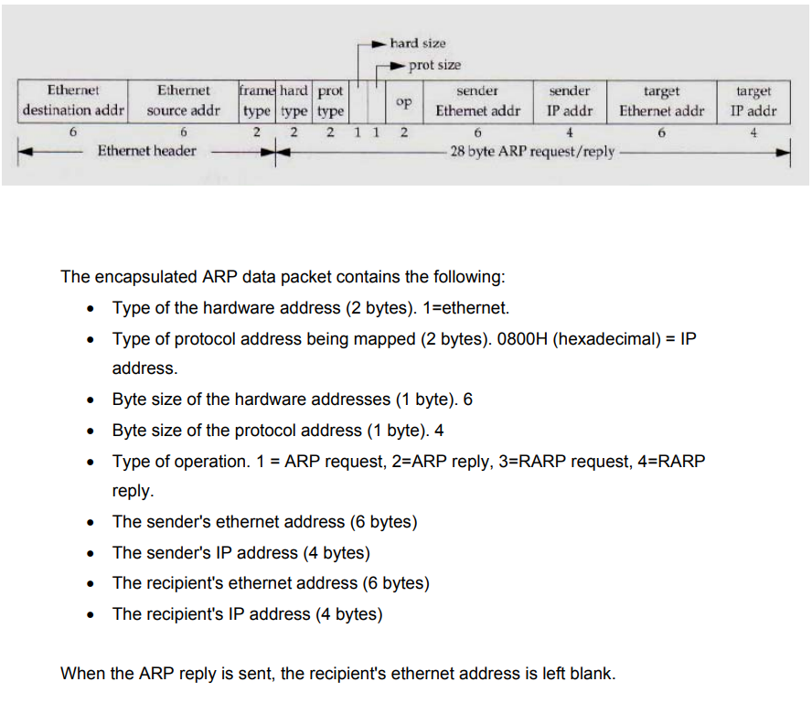
The encapsulated ARP data packet contains the following:
Type of the hardware address (2 bytes). 1=ethernet.
Type of protocol address being mapped (2 bytes). 0800H (hexadecimal) = IP address.
Byte size of the hardware addresses (1 byte). 6
Byte size of the protocol address (1 byte). 4
Type of operation. 1 ARP request, 2=ARP reply, 3=RARP request, 4-RARP reply.
The sender's ethernet address (6 bytes)
The sender's IP address (4 bytes)
The recipient's ethernet address (6 bytes)
The recipient's IP address (4 bytes)

Slide 7

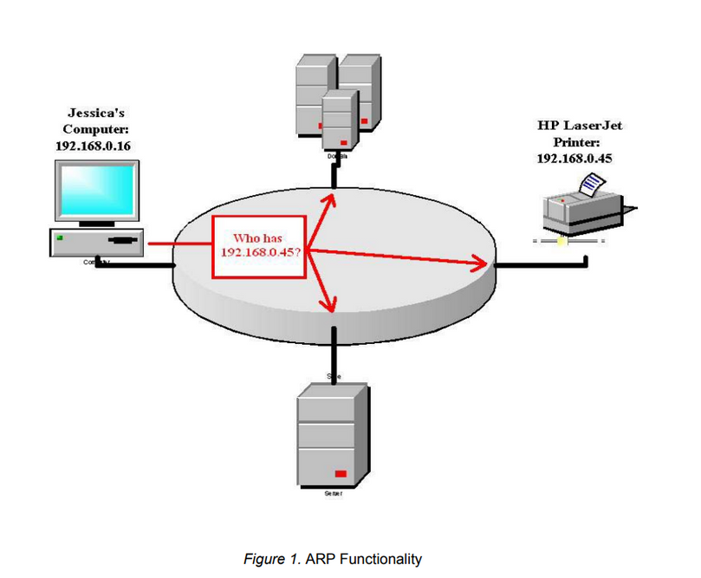
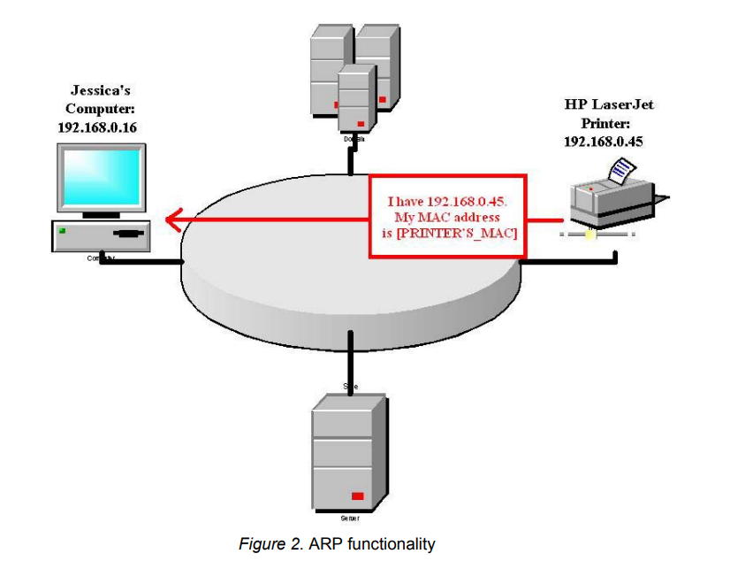
We broadcasat an ARP request to all devices on the local area network, specifying the target IP address as the destination.
The device with the matching IP address will respond to Device A, which will then update its ARP table for future communication.

Slide 8
STEPS IN ARP SPOOFING ATTACK
SENDER
REQUEST
RESPONSE
MITM POSITION
PACKET MANIPULATION
SENDER DEVICE BROADCASTS THE RECEIVER IP TO GET THE RECEIVER MAC
CONNECTION ESTABLISHMENT: CONNECTION IS ESTABLISHED BETWEEN THE ACTUAL SENDER AND RECEIVER.
THE ATTACKER SENDS SPOOFED ARP MESSAGES LINKING THEIR MAC TO THE TARGET'S IP
THE ATTACKER CAN DROP, INTERCEPT, OR MODIFY DATA INTRANSIT.

Slide 9
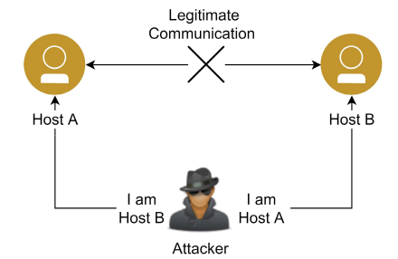
Attackers send falsified ARP messages over a network, linking their MAC address with the IP address of a legitimate network device, causing traffic meant for that device to be sent to the attacker.
Since ARP is a stateless i.e hosts A and B assume they sent an ARP request at some point in the past and update their ARP caches with this new information.
ARP Spoofing is only applicable to Ethernet networks

Slide 10
ARP ATTACKS :
Sniffing
Man in the Middle
Denial of Service
MAC Flooding
Cloning

Slide 11
CONSEQUENCES
C
I
A
CONFIDENTIALITY
INTEGRITY
AVAILABILITY
Packet Sniffing and Data Confidentiality :
Packet Injection:
Denial of Service (DOS) :
The attacker may inject
malicious code or
payload into the traffic
The attacker can disrupt
communication by
blocking data flow
Hijacking and information
theft may occur

Slide 12
Arp Defenses :
Use VPN
Dynamic ARP Inspection
Use Packet Filtering
Static ARP Entries
Reduce the ARP cache time

Slide 13
Arp Detection :
Arpwatch
Use Intrusion Detection Systems
Reverse ARP Lookup (RARP)
Arpwatch is used for monitoring ARP traffic and detecting anomalies like ARP spoofing.
Intrusion Detection Systems (IDS) monitor for suspicious activity on the network or hosts, alerting administrators of possible security threats.
RARP was an early protocol for devices to obtain their IP address based on their MAC address but is now largely replaced by DHCP for IP address assignment and management.

Slide 14
Operating Systems Vulnerable to ARP Spoofing:
Windows NT
Windows XP
Windows 95/98/2000
Linux
Netgear
AIX 4.3
OS not Vulnerable to ARP Spoofing:
Sun Solaris Systems

Slide 15
THANK YOU

